Slide 1


bmcs group
Projects / Software Package Structure
Local evaluation of energy dissipation → fracture energy
Rostislav Chudoba
Institute of Structural Concrete

Slide 2
topics

Slide 3
Structure of repos and packages in the bmcs-group
Data Processing
High-Cycle-Fatigue-Data high-cycle-fatigue-tool @hs
Respose Surface Ironing rs_iron @jb
Crack detection tool dic_cdt @vs
Semianalytical models
Probabilistic multiple-cracking model bmcs_fragmentation @hs
Shear zone bmcs_shear_zone @fs
Reinforced beam response bmcs_beam @sr
Numerical models
Material model development bmcs_matmod @ab @mar
Nonlinear finite element simulator bmcs_nlfes @rc @ab
Folding process oricreate @rc
Discrete particle latice model dplm @rch @mar
Notes:
Scale up in size compared to small scale studies. The size was 3 m times 2,14 m. The crease pattern and the final form werde determined by geometric considerations.
Note: this is only for simple cases possible
Concept for folding: Steel ropes placed underneath the fabric along the crease lines → lifting
Folding with scaffolding and gravitational force.
Within the final configuration the creases were fixed with grout. No movement possible anymore.
Alternative approach for folding with another barrel vault

Slide 4
Specialized model applications – hierarchy
Bar – uniaxial tension
Pull-out analytical / numerical
Crack bridge analytical / numerical
Tensile test analytical
Reinforced beam
Moment-curvature CS designer
Reinforced beam deflection – SLS design
Beam stability analysis
Reinforced beam
Shear zone - discrete crack
RC beam simulator
Notes:
Scale up in size compared to small scale studies. The size was 3 m times 2,14 m. The crease pattern and the final form werde determined by geometric considerations.
Note: this is only for simple cases possible
Concept for folding: Steel ropes placed underneath the fabric along the crease lines → lifting
Folding with scaffolding and gravitational force.
Within the final configuration the creases were fixed with grout. No movement possible anymore.
Alternative approach for folding with another barrel vault

Slide 5
Numerical standalone model applications
Matetial model demonstrators
Slide model monotonic / cyclic / fatigue
Microplane model monotonic / cyclic / fatigue
Test simulators (matmod + nlfes)
Compression test
Pull-out Test
Notched cylinder shear test
Beam – combined bending / tension compression
Notes:
Scale up in size compared to small scale studies. The size was 3 m times 2,14 m. The crease pattern and the final form werde determined by geometric considerations.
Note: this is only for simple cases possible
Concept for folding: Steel ropes placed underneath the fabric along the crease lines → lifting
Folding with scaffolding and gravitational force.
Within the final configuration the creases were fixed with grout. No movement possible anymore.
Alternative approach for folding with another barrel vault

Slide 6

This is really useful! We can evaluate dissipated energy locally!
If we know where the localization and crack propagation occurs,
we can focus just onto this region and ignore the non-dissipative (elastic/unloading) rest of the domain
→ this is the fundamental concept behind methods describing fracture

Slide 7


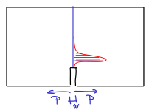
How to evaluate energy dissipation?
ideal plasticity

Slide 8




How to evaluate energy dissipation?
ideal plasticity

Slide 9
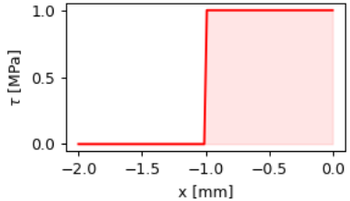
How to evaluate energy dissipation?
ideal plasticity
this only holds for
a bond-slip law with
constant stress

Slide 10
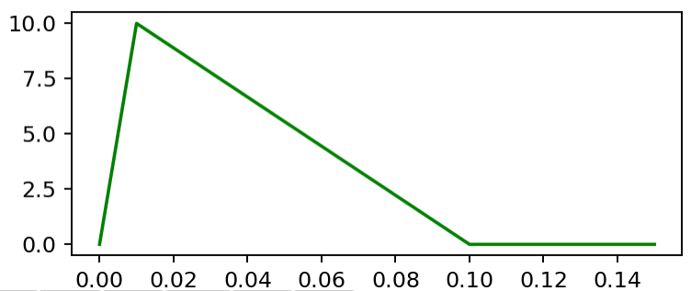
How to evaluate energy dissipation – for softening materials?
ideal plasticity
for a general bond-slip law we have to take a time
integral of a energy release rate

Slide 11



How to evaluate energy dissipation – for softening materials?
ideal plasticity
softening/hardening plasticity
damage
(see thermodynamics)

Slide 12
softening material behavior localization strains into a discontinuity energy dissipation can be related to a localized crack
Fundamental idea behind the fracture energy

Slide 13
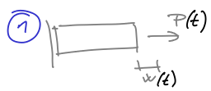
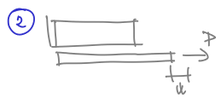

Consequences of softening behavior

Slide 14
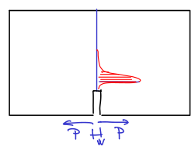
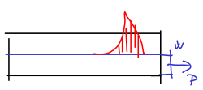
Why Is it important to evaluate energy dissipation → fracture energy?
The fact that energy dissipates locally
leads to the idea that it is independent
on the size and on boundary conditions
→ objective material property
A

Slide 15
Example
Consider a bond-slip law
with softening

Slide 16
Example
Consider a bond-slip law
with softening

Slide 17
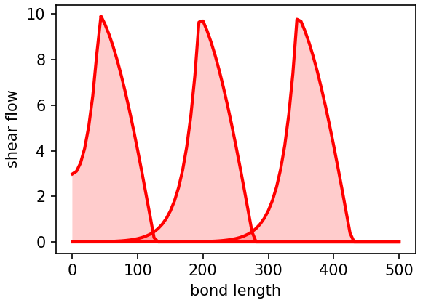
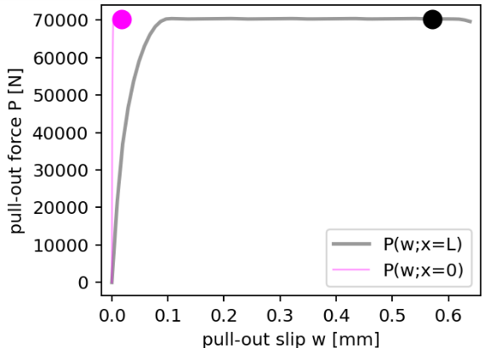
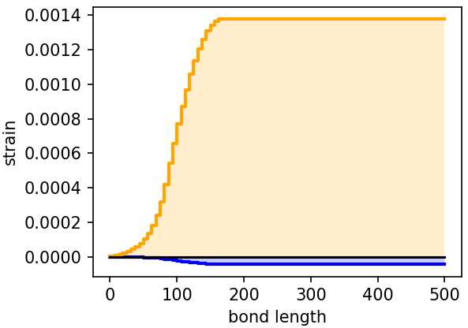
Example

Slide 18
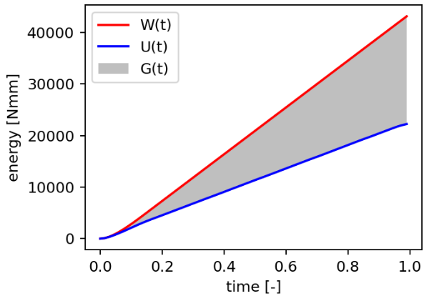
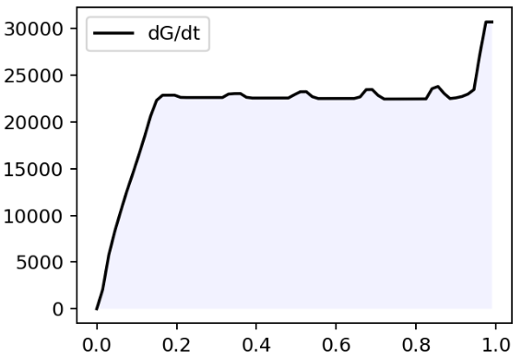
Example

Slide 19
Example
Observation: constant rate of energy dissipation
→ stable process, independent on BC
→ objectivity → material characteristics
Energy dissipated per unit area?

Slide 20
Example
Observation: constant rate of energy dissipation
→ stable process, independent on BC
→ objectivity → material characteristics
Energy dissipated per unit area?
?

Slide 21
Conclusion – how to determine fracture energy?
1 – Run a test
2 – Evaluate the area below the P(w) curve
3 – Subtract stored energy
4 – Divide by the total debonded interface area
?

Slide 22

How to predict the total dissipated energy without simulation?
Regarding the softening bond-slip law
→ We don’t need to know
Q: Does the total dissipated energy change for d = 4mm?

Slide 23
Consequences?
No volume integrals necessary, no state variables necessary
To obtain the fracture energy we need
a test with a clearly observable discontinuity
of a known area
The test should ideally
reach zero level of
Then

Slide 24
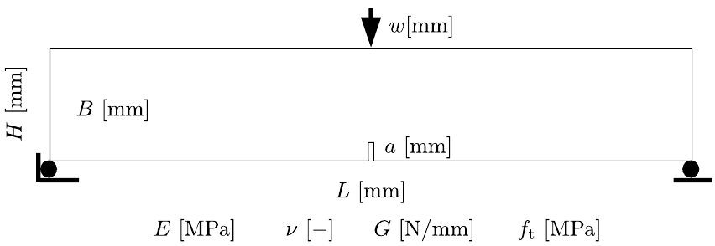
Fracture energy of concrete cracking

Slide 25
Fracture energy of concrete cracking

Slide 26
Fracture energy of concrete cracking

Slide 27
Usage of fracture energy
Calibrate the softening branch of
a cohesive crack model – the measure
of ductility of quasi-brittleness of the material
By calibrating the softening law
from the curve of a beam with depth
we can predict the curve of a beam with depth
Softening law can be transformed to damage function
and applied in finite element simulations

Slide 28
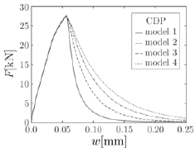
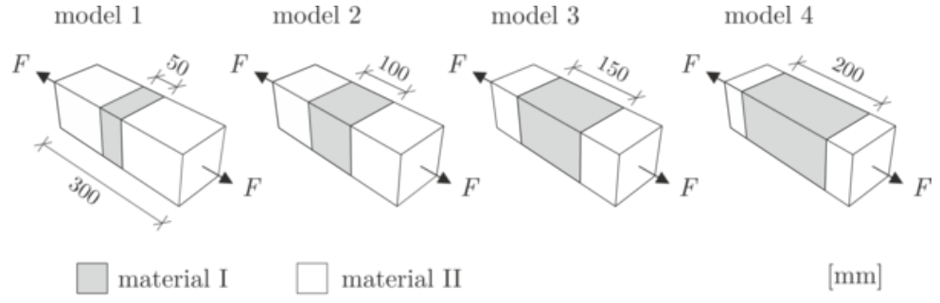
Usage of fracture energy – outlook
Regularize finite-element models
of concrete cracking to deliver mesh
independent results

Slide 29
Possible tasks
Given a measured force-displacement curve from pull-out
or from a bending test derive the fracture energy characterizing
the localization process of the interface or concrete matrix
Given a material strength and fracture energy, derive a
bond-slip law or crack opening law
Exercise: X0601 – Energy supply and dissipated energy

